Slide 1
Azure Zero Trust IoT Data Collection System
Team #8, Azure Zero Trust IoT
Project Faculty Advisor: Professor Brendan D. Saltaformaggio
External Partner: Dr. John D. Williams (Boeing), Michael F. Mitchell (Boeing)
James Thomas Computer Engineering jthomas8@gatech.edu
Aaron J Wasserman Computer Engineering wasserman@gatech.edu
Jayla Williams Computer Engineering jwilliams664@gatech.edu
Noah G Dorfman Computer Engineering n.dorfman00@gatech.edu
Zixuan Kang Computer Engineering zkang35@gatech.edu

Slide 2
Overview/Agenda
Introduction
Objectives
Motivation
Background
Project Description and Goals
Technical Specification
Design Approach and Details
MQTT vs AMQP
RP4 vs LTE
Project Demonstration Plan
Schedule, Tasks and Milestones (Planned)
Schedule Changes (Modified and purchasing problems)
Marketing and Cost Analysis
Leadership Roles
Next Steps

Slide 3
Objectives
Design and prototype a secure IoT system for data collection and remote storage
Nordic microcontroller devices to form bluetooth, data-collection mesh
Transmit data via cellular connection to Azure IoT Hub cloud platform
Employ Azure Zero Trust framework throughout
Demonstrate security of the system
Hardware attacks
Network attacks
Software attacks
Nordic
IoT Hub
Nordic
Nordic
Nordic

Slide 4
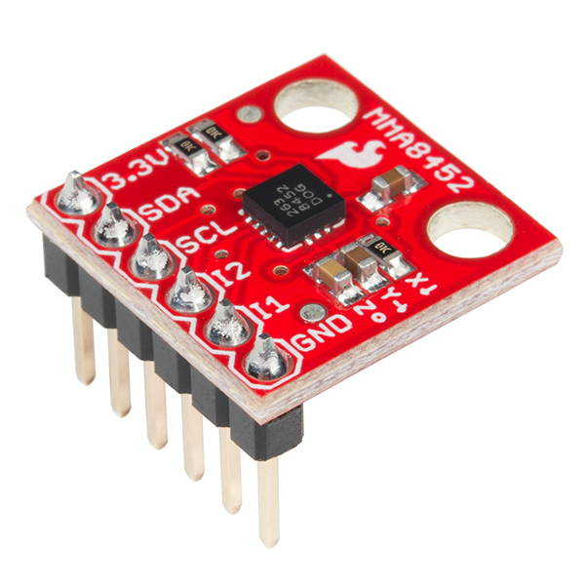
Motivation
CPS/IoT improves our daily lives
5G initiative
Provide information protection and monetization
Notes:
Like how Mark Weiser published in his Ubiquitous Computing in 1993, modern IoT devices promise to improve our daily lives by recording and analyzing the health and status of the world around us. This promise will be achieved using thousands of sensors continually recording and mapping temperature, vibration, luminescence, acceleration, velocity, humidity, heartbeat, oxygen content, color, and mood of the human existence. Combined with the promise of 5G, the world as we know it will soon change. However, this revolution will be short-lived without a means to protect and monetize the information and prevent others from stealing and making use of one’s data. By developing the Azure Zero Trust IoT Network, the team hopes to increase security in the IoT networks for data collection in an easily deployable, well-vetted package

Slide 5
Background
Past: Castle-and-Moat Approach
IPv4/IPv6
Verify IP addresses
Geographical Location
Nowadays: Cloud Services/Outsourcing Server
Once the system is conquered, nothing in there is safe.
Lateral attack
Solution: Always verify, never trust -- Zero Trust Architecture (ZTA)
Microsoft Authenticator
Duo Mobile
Notes:
Historically, company servers resided inside the company network or within the company's geolocation. As a result, the company can easily define the border or the protection surface, which in this case is the server center of the company, and it is a feasible solution to prevent potential attacks through verifying the IPv4/IPv6 addresses, blocking access request outside the geolocation these addresses indicated and trusting all accesses within the company network (Castle-and-Moat Approach, CMA). However, as more companies and business models are using cloud services and outsourcing server needs, the conventional CMA is obsolete. Some of the most egregious data breaches happened because hackers could move laterally through the internal system without much resistance. Under such circumstances, even the access from the internal network cannot be trusted anymore and thus leading to the ZTA, namely, always verifying and stop trusting. When it comes to the cybersecurity of IoT devices, application of this new cybersecurity architecture is of great urgency.

Slide 6
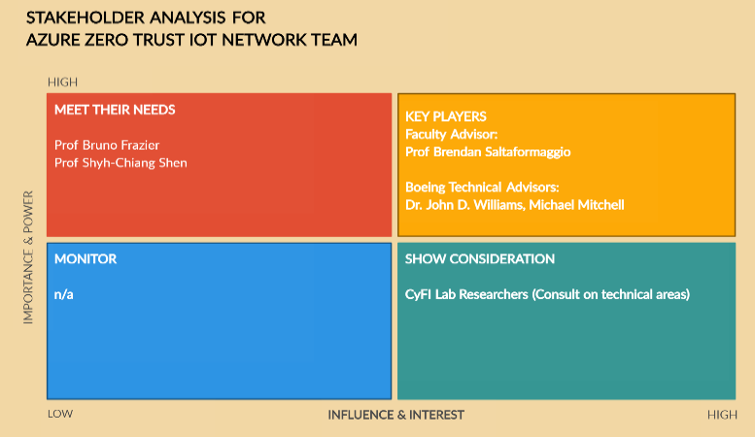
Project Description and Goals
Relatively inexpensive, secure, IoT data collection system
Use Nordic devices that can support:
BLE mesh
LTE data transmission
Follow Azure Zero Trust framework
Network traffic security
Software development practices

Slide 7
Technical Specifications
General System Security
Item | Specification
Supported Number of Devices in Network | > 2 nodes
Cost | < $500
Data Collection Frequency | 100 Hz
Battery Life (minimum) | 4 hours
Item | Specification
Zero Trust Protocol | 1 handshake/transmission
Hardware Access to Sensor Data | 0 known vulnerable side-channel vectors
Software Access to Sensor Data | 0 leaks to non-authorized accesses
Resistance to “Fuzzing” | 0 device crashes

Slide 8
Design Approach and Details -- MQTT vs AMQP
AMQP | MQTT
Can be more secure. More configurable For Azure, AMQP is needed for using their service endpoints For Azure, Microsoft offers various security features with AMQP | Low overhead Simple to implement and send data from embedded systems. Best for many small messages on low-bandwidth networks For Azure, MQTT works well with Azure Data Lake Storage For Azure, IoT Protocol Gateway offers a way to bridge to AMQP if a service offering from MS is required

Slide 9
Design Approach and Details -- RP4 vs LTE
LTE | Separate Gateway (RP4)
Lightweight system (eliminate the need for extra devices) useful everywhere with a cellular connection Security less complicated | Initialization is easier. More existing community support More versatile Allows for more complicated tasks to be completed. Useful for future applications (doing work on the network edge, rather than going to the server for everything)

Slide 10
Project Demonstration Plan
Functional Demo
Present a functional mesh network of Nordic devices actively measuring and transmitting environmental data to a database
Have laptop showing the data updating in real time w/ minimum sampling rate spec shown
Dummy System Demo
Poster detailing attacks tested on the system showing robustness against common attack vectors
Show a dummy system implemented on a Raspberry Pi or similar where the attacks are successful side by side with the attacks failing on our system

Slide 11
Schedule, Tasks, and Milestones (Planned)
Intent was to complete the following tasks over the summer
Order nordic devices
Test program reading data
Setup BLE mesh network
Setup cloud services
Setup comms with server
Test basic functionality
Would’ve left only the vulnerability assessment, patching, and presentation/documentation preparation for the fall
A delay on purchasing has caused us to have to adjust this schedule

Slide 12
Schedule Changes (Modified after purchasing problems)
Original plan was to get mesh network functionality completed over summer
Intended to leave more time for vulnerability screening and patching in the fall
Attempted to purchase the nordic devices however our requests were pushed back while they were setting up the purchasing/reimbursement system
As of last week purchasing still isn’t live so we still have had no development time with hardware
Will expedite system development at the front of the semester to leave as much time for security assessment and patching as possible
May have to focus on a smaller portion of the attack surface for the system

Slide 13
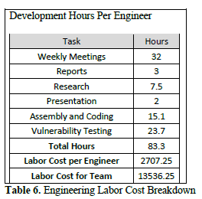
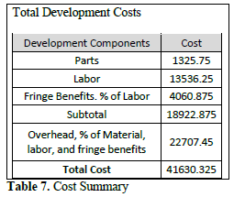
Marketing and Cost Analysis
Please review the proposal document for detailed breakdown of costs and for market research
Item | Unit Cost | Quantity | Cost
NRF6943 (Thingy:91) | 126.25 | 4 devices | 505.00
USB A to Micro 5 pack | 21.99 | 1 | 21.99
USB A to wall 5 pack | 10.75 | 1 | 10.75
 |  | Total | 536.74 + s/h

Slide 14
Leadership Roles
Jayla Williams - Webmaster, Networking Lead
Aaron Wasserman - Expo Coordinator, Hardware Security Testing Lead
James Thomas - Azure IoT Software Lead
Noah Dorfman - Documentation, Embedded Hardware Lead
Harry Kang - Implementation Testing, Embedded Software Lead

Slide 15
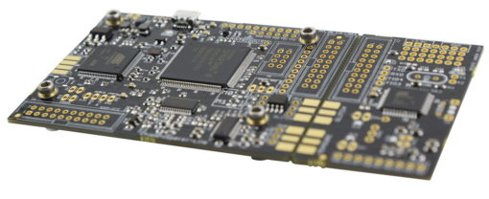
Attack Plan
Hardware:
Wiretapping
Power Analysis Attack
VFI Glitching Attacks
Check for Radiation, Single Event Upset
Software:
Wireless Attack (Wireshark)
Wired Attack
Fuzzing

Slide 16
Next Steps
Deliver Proposal Presentation (Right now!)
Revise project proposal and summary with feedback
Continue escalating our purchasing requests
Need hardware in hand to keep moving forward
Already behind on our original schedule since purchasing wasn’t supported during the summer
Finalize weekly group meeting time

Slide 17
Questions?

