Slide 1
Ecolymer River Cleanup Robot
Systems Integration of an Unmanned Surface Vehicle for Autonomous Removal of Plastic Waste in Aquatic Environments
ECE 4872: Final Semester ECE Senior Design
9/21/2021
Notes:
Tan

Slide 2
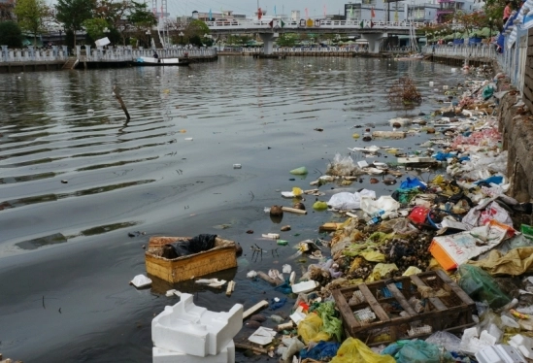
Project Background
United Nations Sustainable Development Goal 14.1
Challenges the world to ”prevent and significantly reduce marine pollution of all kinds, in particular from land-based activities” by 2025 [1].
Oceans produce over half the world’s oxygen as well as having an economic impact of $282 billion in the U.S. alone [2].
River systems have a significant impact on this flow of waste as it is estimated that just 1000 rivers contribute 80% of global annual emissions up to the magnitude of 2.7 million metric tons per year [3].
Mekong River [4]
[1] https://sdgs.un.org/goals/goal14
[2] https://oceanservice.noaa.gov/facts/why-care-about-ocean.html
[3] https://theoceancleanup.com/sources
[4] https://www.independent.com/2019/06/02/new-program-targets-down-river-plastic-waste/
Notes:
Tan

Slide 3
Our Team
Alexander Chanthaphaeng
Hardware Lead
Tan Tonge
Project Manager
Jin Bae
Navigation Software Lead
Luis Pimentel
Perception Software Lead
EE - Specializing in Smart Power Grid Control / Renewable Energy Integration
CompE - Specializing in Embedded Systems/Robotics
CompE - Specializing in Robot Control Systems/Machine Learning/Perception
EE - Specializing in Electronics / Hardware Design
Notes:
Tan

Slide 4
Sponsor Needs
Ecolymer desires a fully-automated river clean-up system
Intended to be deployed in waterways to:
Identify plastic waste
Collect the waste
Dispose of the waste
Without interfering with river traffic or aquatic life
Developing a prototype proof-of-concept of their desired solution
Focusing on the limiting technologies to accomplishing these operations
Notes:
Tan

Slide 5
Design Objectives
Continuing the development from 2 prior semesters of Senior Design
Fall 2020 - Trash Detection through YOLO
Spring 2021 - Collision Avoidance with Xbox Kinect
Fall 2021 - Integration onto USV platform to achieve autonomous navigation
Leveraging existing Unmanned Surface Vehicle (USV) platform to avoid hardware development time
Integrating commercial and readily-available solutions
Reduce costs and improve feasibility of final product
Notes:
Tan

Slide 6
Explanation of Design

Slide 7
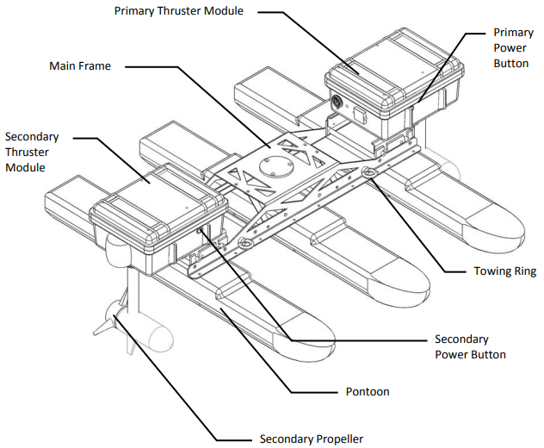
Base Robot Platform
Kingfisher M100 has been identified as the proof-of-concept USV platform
Kingfisher M100 and its components [1]
[1] https://oceanai.mit.edu/svn/moos-ivp-kfish/trunk/docs/kfish-m100-manual.pdf
Notes:
Alex - For the base robot platform, as shown here is the Kingfisher M100 as provided by Dr. West, it has been identified as the proof of concept USV platform. We were provided this so time wouldn’t be wasted on building a USV from scratch. As you can see, the Kingfisher consists of a 2 thruster modules, each having an individual motor providing differential thrusts.

Slide 8
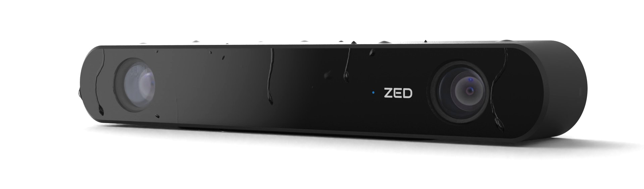
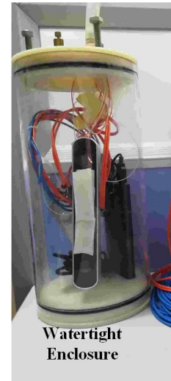
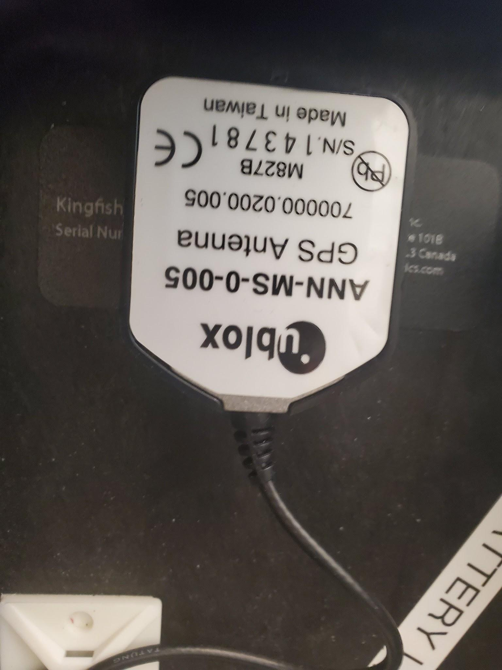
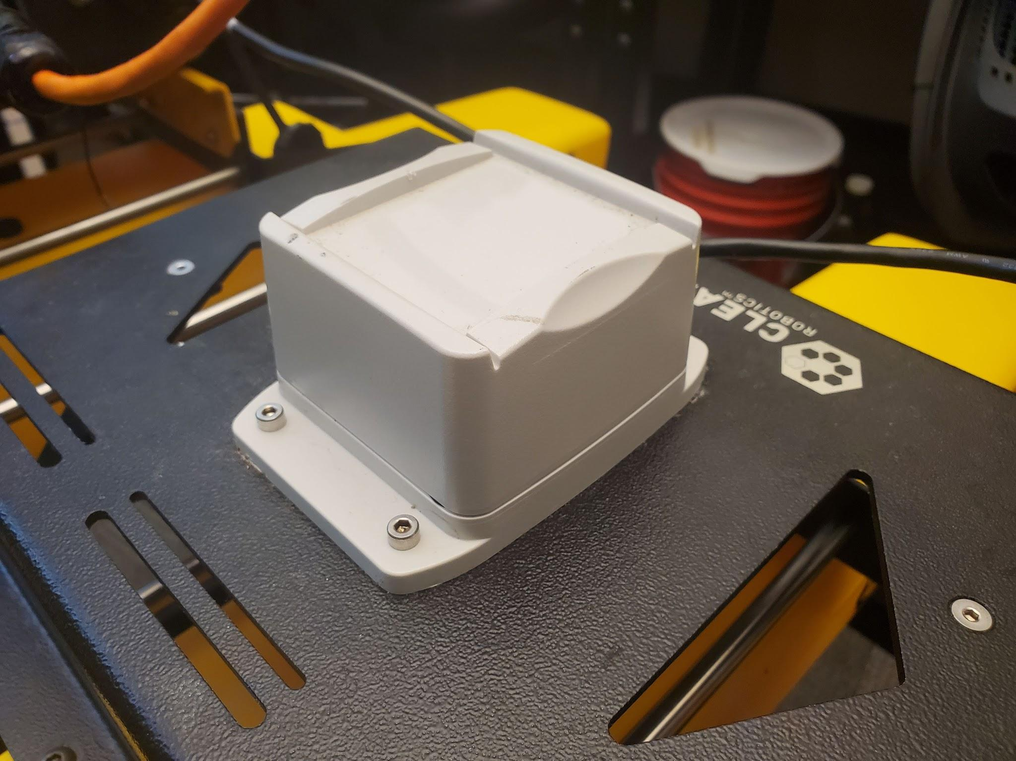
Sensors
ZED 2i [1]
GPS Module: vehicle’s position in body of water
Inertial Measurement Unit (IMU): vehicle’s orientation
ZED 2i: stereo vision camera for trash detection and depth sensing
To be placed in a forward-facing waterproof enclosure [1]
IMU
GPS
[1] https://ieeexplore.ieee.org/stamp/stamp.jsp?arnumber=8867236
Notes:
Alex- We will be using 3 sensors in our design. There will be a GPS module for the Kingfisher’s position in the water, an IMU for vehicle orientation, and a Zed 2i stereo vision camera for trash detection and depth sensing and is expected to be placed in a forward facing orientation inside a waterproof enclosure. Based on IEEE paper cited, the Zed 2i has been proven to work underwater, but it would require calibration.

Slide 9
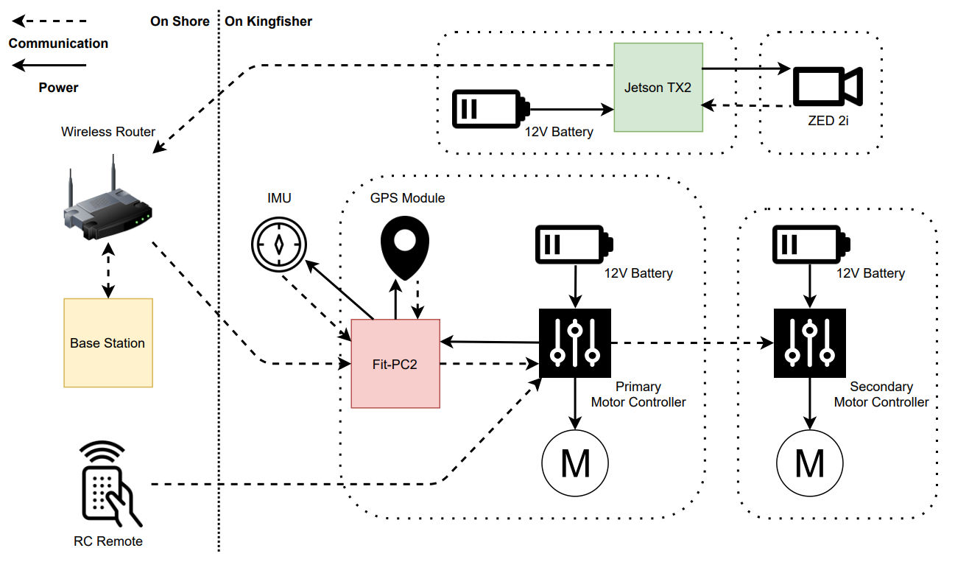
Hardware Architecture
Notes:
Tan

Slide 10
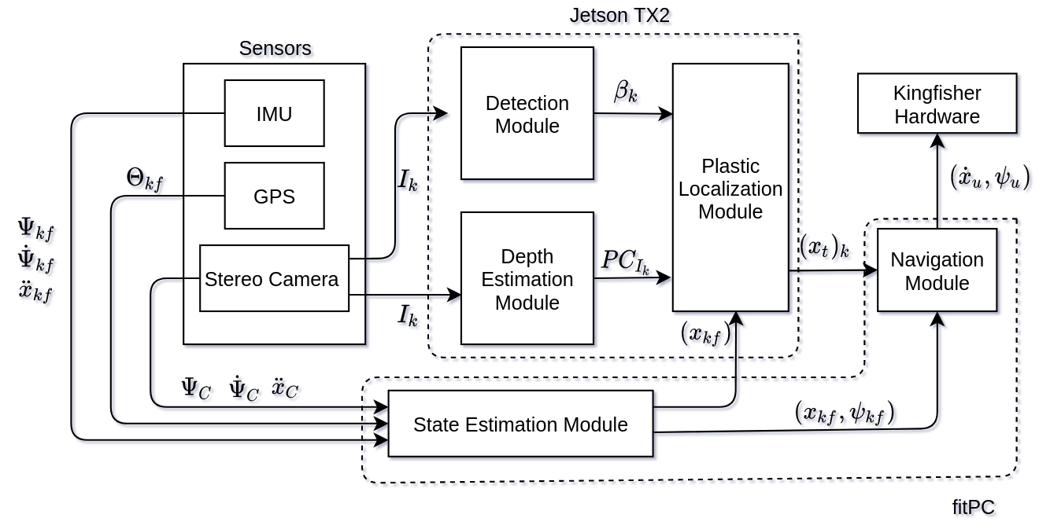
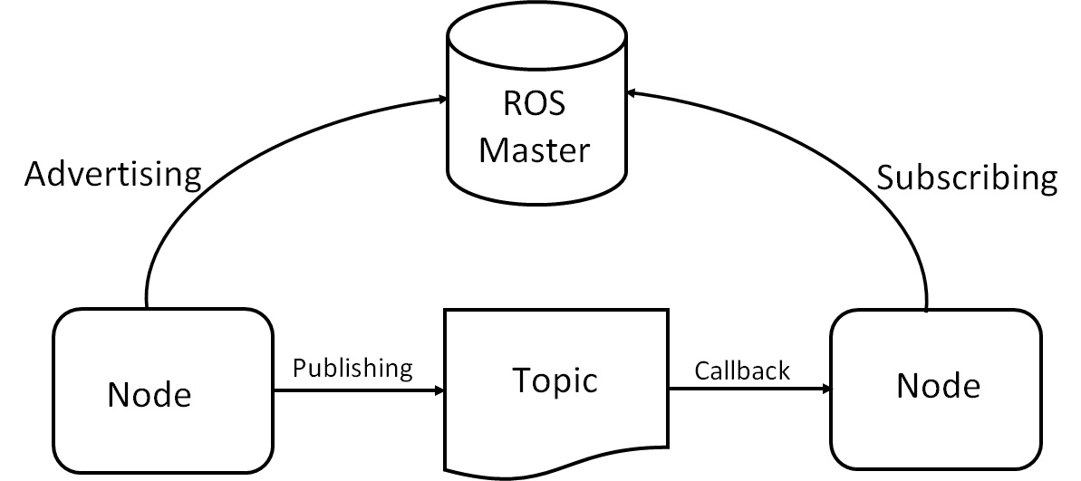
Software Architecture
Our software architecture consists of 5 main modules:
Detection Module: detects plastic in an image frame
Depth Estimation Module: outputs detected 3D point-cloud data
Plastic Localization Module: estimate the positions of the trash
State Estimation Module: outputs robot state estimates
Navigation Module: outputs commanded velocities to KF
Utilizing the Robot Operating System (ROS) [1] for communication between modules
[1] https://www.ros.org
[2] https://www.designnews.com/gadget-freak/ros-101-intro-robot-operating-system
Notes:
N

Slide 11
Perception: detection of underwater plastic waste
Underwater plastic water will be detected using a real-time performing object detection system: Yolov2 [1].
Runs images through a neural network with the ability to classify and localize an object
Outputs the bounding boxes (relative pixel locations) around the detected object
The pre-trained weights on the trash_ICRA19 [2] dataset will be used
Trained to detect three object classes: plastic, marine biology, and ROV (remotely operated vehicle)
[1] https://pjreddie.com/darknet/yolov2/
[2] https://conservancy.umn.edu/handle/11299/214366

Slide 12
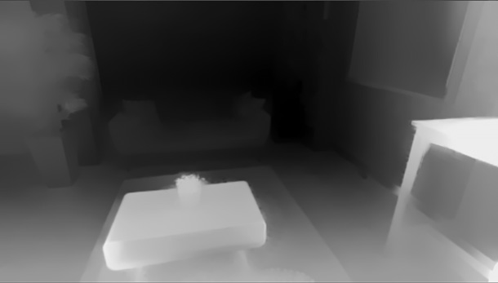
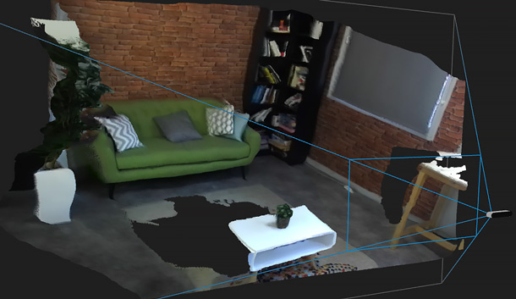
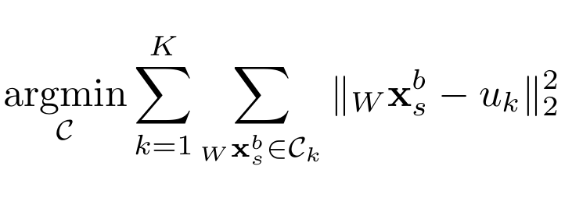
Perception: Depth Estimation
ZED 2i stereo camera captures images of the environment used by the Detection Module and Depth Estimation Module
StereoLabs provides APIs to access its internal depth estimation modules providing:
Depth Estimation Data
scalar distances to objects in image frame
Live Point-cloud Data
3D points relative to the location of the camera
We can then cluster the 3D points perceived within the K bounding boxes detected
We can formally define this as a K-means clustering problem due to possible overlap in bounding boxes that:
assigns 3D points to K clusters
estimates the mean 3D location

Slide 13
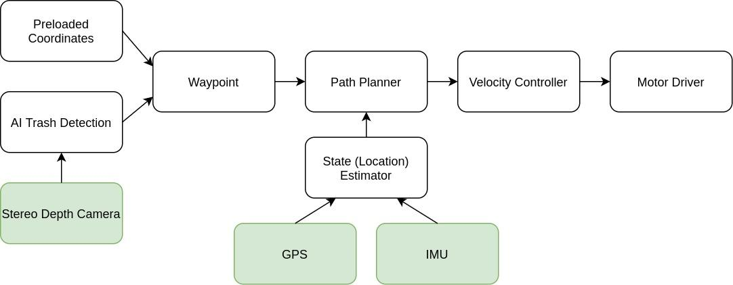
Navigation Pipeline

Slide 14
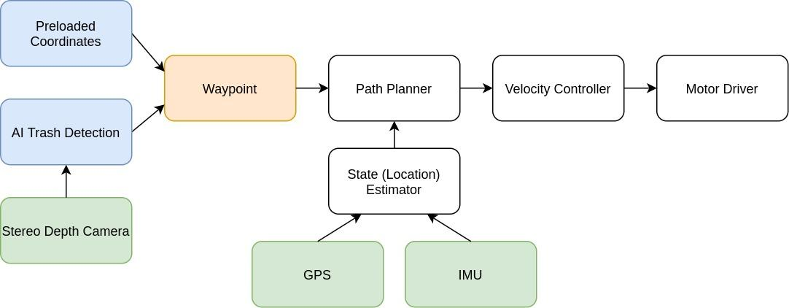
Navigation Pipeline

Slide 15
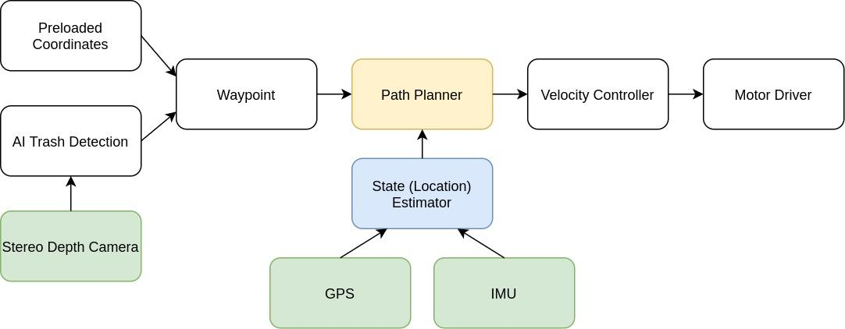
Navigation Pipeline

Slide 16
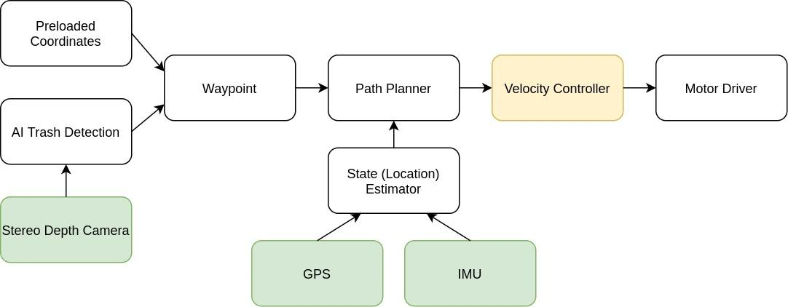
Navigation Pipeline

Slide 17
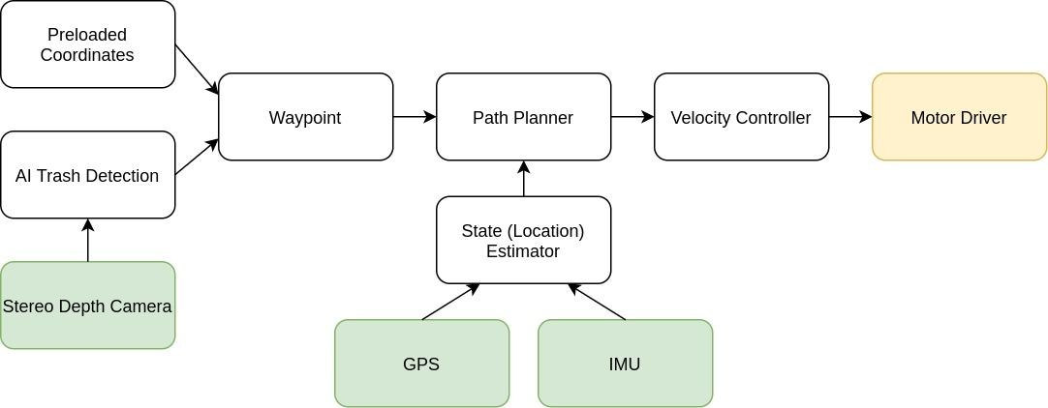
Navigation Pipeline

Slide 18
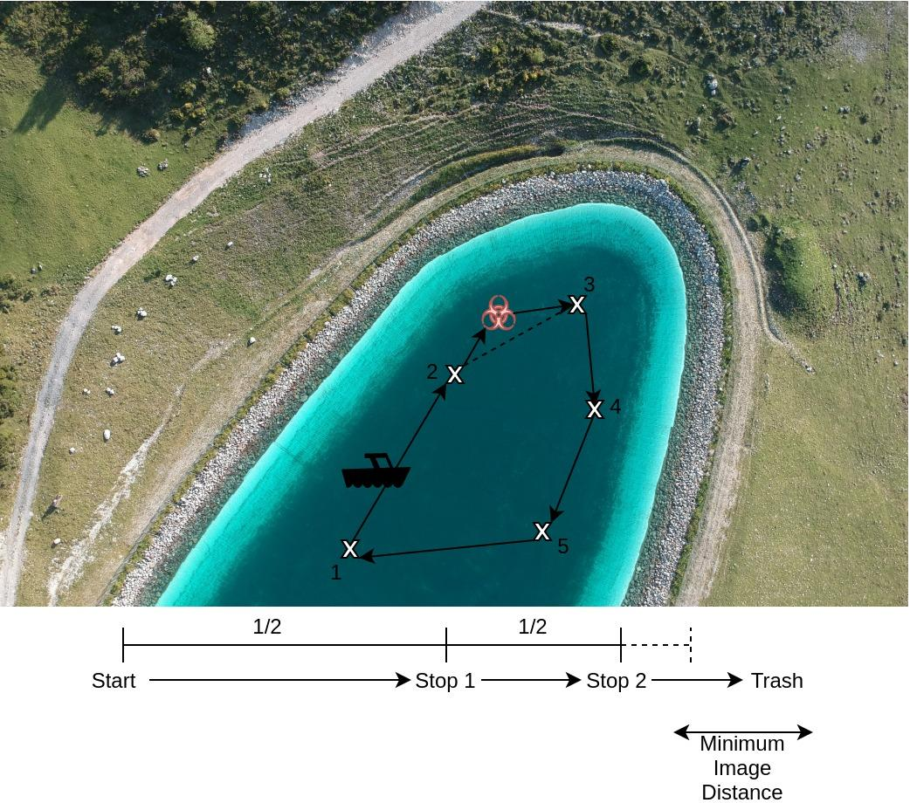
Example Navigation Sequence
waypoints.csv
33.74905° N, 84.38801° W
33.74907° N, 84.38810° W
33.74918° N, 84.38813° W
33.74924° N, 84.38808° W
33.74917° N, 84.38802° W

Slide 19
Project Specifications

Slide 20
Qualitative Goals
Ability to detect trash objects using camera system and pre-trained trash detection model
Ability to localize trash using bounding box and its corresponding depth values
Ability to control the robot’s position and heading through ROS
Ability to navigate robot from a starting point to a trash location
Ability to continuously estimate trash location as trash location drifts
Ability to operate robot for given operational time

Slide 21
Quantitative Specifications
Ability to detect all trash within 3 meters with confidence p >= 0.8
Ability to detect trash locations of:
100% <= 3 meters
60% 3 meters < x <= 10 meters
20% 10 meters < x <= 20 meters
Ability to navigate from starting point to trash locations :
100% <= 3 meters
60% 3 meters < x <= 10 meters
20% 10 meters < x <= 20 meters
Ability to continuously estimate trash location with drift in location of 1 meter
Ability to operate vehicle for 4 hours

Slide 22
Detection Integration Testing
The Idea:
Integrate the ZED 2i camera ensuring successful image streaming capabilities on the Jetson TX2 and perform real-time object detection
Procedure:
Install libraries and dependencies to stream data from the camera to the Jetson.
Mount ZED 2i in a transparent waterproof enclosure, calibrate camera, and validate trash detection underwater.
Mount camera with enclosure on the Kingfisher and place in pool with sample trash objects and non-trash objects at different known locations and different ranges, validating accuracy.
Notes:
Alex- For our testing, we will be running 2 different tests: Detection Integration and Depth Estimation. For the Detection Integration Testing, the idea is to integrate the Zed 2i to ensure successful image streaming capabilities on the Jetson and perform real-time object detection. The way we were going to approach this was to first install the libraries and dependencies to stream data from the camera to the Jetson. Then we would mount the Zed 2i in the waterproof enclosure, calibrate the camera, and validate trash detection underwater. Lastly, we would mount the camera with the enclosure on the Kingfisher and place in pool with sample trash and non-trash objects at different known locations and different ranges, validating accuracy.

Slide 23
Depth Estimation Testing
The Idea:
Using the ZED2i camera’s depth capabilities, estimate the 3D locations of trash.
The Procedure:
Develop depth estimation pipeline with ZED 2i camera and validate in lab.
Install camera in a transparent waterproof enclosure and validate depth estimation in a water tank.
Mount camera with enclosure on the Kingfisher and place in pool with with sample trash objects at different known locations and different ranges, validating accuracy of depth estimation.
Notes:
Alex- For the Depth Estimation test, the idea is the use the Zed 2i camera’s depth capabilities to estimate the 3d locations of trash. To do this, we plan to first develop a depth estimation pipeline with the Zed 2i and validate the results in lab. Then, we would install the camera in the waterproof enclosure and validate depth estimation in a water tank. Lastly, we would mount the enclosure with the camera inside onto the Kingfisher and place in a pool with sample trash objects like plastic bottles and bags at different known locations and different ranges. We would then validate the accuracy of the depth estimation

Slide 24
Collision Avoidance and Navigation Testing
The Idea:
Use the collision avoidance and navigation from Spring 2021 team.
Test navigation and collision avoidance capabilities in a water environment before full systems test.
Transform and navigate coordinates in the local frame, using global GPS frame.
Procedure:
Have obstacles in a pool or lake environment (buoys, tree branches, makeshift boats).
Run collision avoidance and navigation on Kingfisher from Spring 2021 team.
Navigate Kingfisher in the water.

Slide 25
Current Project Status

Slide 26
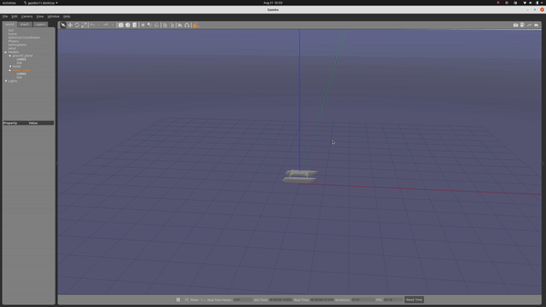
Current Status
Have new fitPC to replace original with broken port
Functioning ROS node doing object detection on real-time video stream using Yolov2
Image frame detection comes in at ~2Hz, likely sufficient for our application
Detection at ~9Hz using tiny_yolo. Less accurate, more false positive detections
Gazebo simulation of a Autonomous Surface Vehicle (ASV) using latest ROS/Gazebo libraries
Implemented a thruster model, dynamics model, and sensor models (IMU and GPS)
Allows us to test code that will can drive the robot through ROS
Adapted from Kingfisher_gazebo [1] and usv_gazebo_plugin [2].
[1] https://github.com/bsb808/kingfisher_gazebo
[2] https://github.com/bsb808/usv_gazebo_plugins
Notes:
Luis

Slide 27
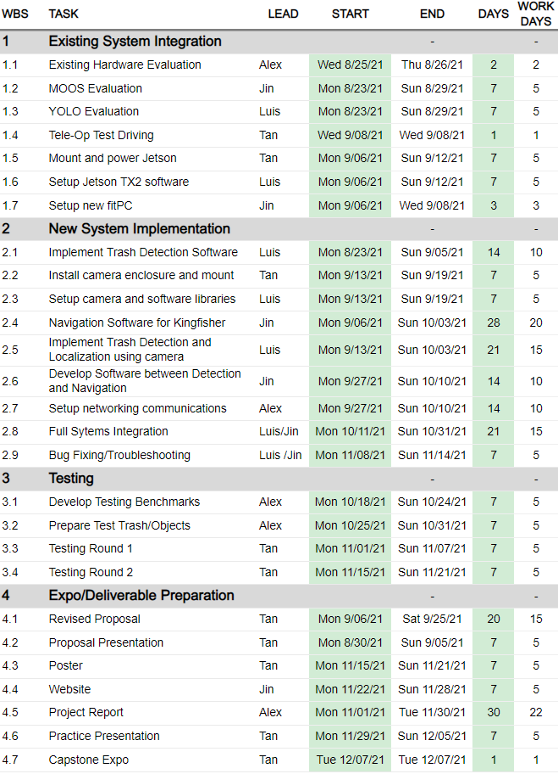
Project Schedule
Notes:
Luis

Slide 28
Questions?

